Slide 1
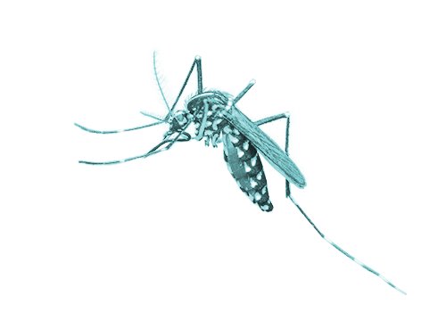
WEST NILE virus
Project 4
Jiansheng | Le-Anne | Shaun

Slide 2


Intro/Background
West Nile Virus (WNV) is the leading cause of mosquito-borne disease in the United States (Centers for Disease and Control Prevention, 2019). It is most commonly spread to people by the bite of an infected mosquito.
1 out of 5
1 out of 150
Fever/other symptoms
Serious/fatal illness
Risk of WNV can be reduced by controlling the mosquito population to prevent the spread of WNV.

Slide 3
Problem Statement
Which part of Chicago do we want to deploy pesticides?
Methodology:
Predict the presence of the West Nile Virus.
Evaluate the effectiveness of spray
Recommend a deployment plan for the pesticides throughout the city of Chicago.

Slide 4






Workflow
Dataset
Cleaning & Considerations
EDA
Feature Engineering
Model Evaluation & Selection
Cost-benefit Analysis

Slide 5
Dataset
Test
Id (2008,10,12,14) Date Address Species Block Street Trap AddressNumberAndStreet Latitude Longitude Address Accuracy
Train
Date (2007, 09, 11, 13) Address Species Block Street Trap AddressNumberAndStreet Latitude Longitude Address Accuracy NumMosquitos WnvPresent
Sunrise Sunset Codesum Depth Water1 Snowfall PreciTotal StnPressure
Weather
Station Date (2007-14) T.max T.min T.avg Depart Dewpoint Wetbulb Heat Cool
Sealevel Resultspeed Resultdir Avgspeed
Spray
Date (2011,13) Time Latitude Longitude

Slide 6
Cleaning & Considerations
Train
Removing 813 duplicate entries
Changing date format
Merging the insignificant species that contribute to the WNV into ‘others’
Dropping block, address, street, addressnumberandstreet & address accuracy
Check and removing null values
Convert all satellite trap to same trap name as parent trap
Weather
Changing date format
Check and remove for ‘M’ (missing) values
Dropping Tmin, Tmax, Depart, Heat, Cool, Sunrise, Sunset, Codesum, Depth, Water1, Snowfall, StnPressure, Avgspeed
Test
Changing date format
Merging the species to match Train dataset
Dropping block, address, street, addressnumberandstreet & address accuracy
Convert all satellite trap to same trap name as parent trap
Spray
Changing date format
Removing 541 duplicate entries

Slide 7
Filtered Predictors
Feature Engineering
Weather Station Date (2007-14) T.avg PreciTotal Sealevel Resultspeed Resultdir Relative Humidity Longitude Latitude
Train Date (2007, 09, 11, 13) Species Trap Latitude Longitude NumMosquitos {WnvPresent} Tot_mos_species
Train
Tot_mos_species: Sum of the species that have WvnPresent within each trap.
Converting Months (in Date) into Cos/Sin function
Weather
Using Dewpoint & Wetbulb, calculate Saturated Vapour Pressure (SVP) & Vapour Pressure (VP)
Using SVP & VP to calculate Relative Humidity
Adding Longitude & Latitude for all entries: Station 1: (41.995, -87.933) Station 2: (41.786, -87.752)
Test Id Date (2008,10,12,14) Species Trap Latitude Longitude
Spray
Date (2011,13) Time Latitude Longitude

Slide 8
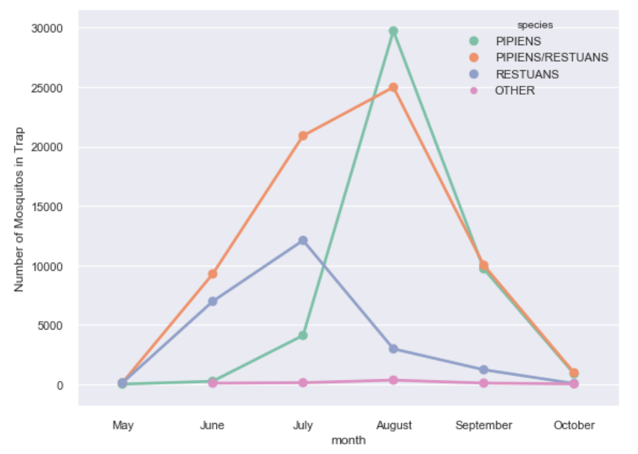
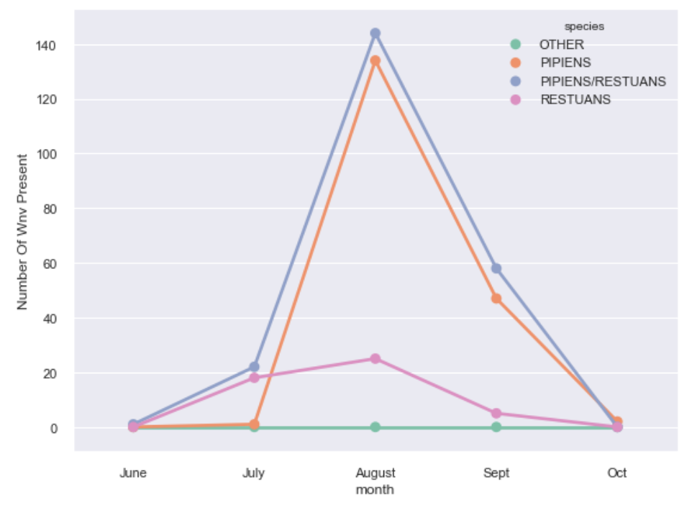
EDA - Species of Mos. Trapped
EDA - Species of Mos. w. WNV Present
Notes:
Difference between 2 graphs : y-axis
Indicators are sum of species across years. Only showing season trends
Note the different colors of legend for species
Findings: pipiens & piiens/restuans are the main 2 breed that is present dominantly between month of july to sept

Slide 9
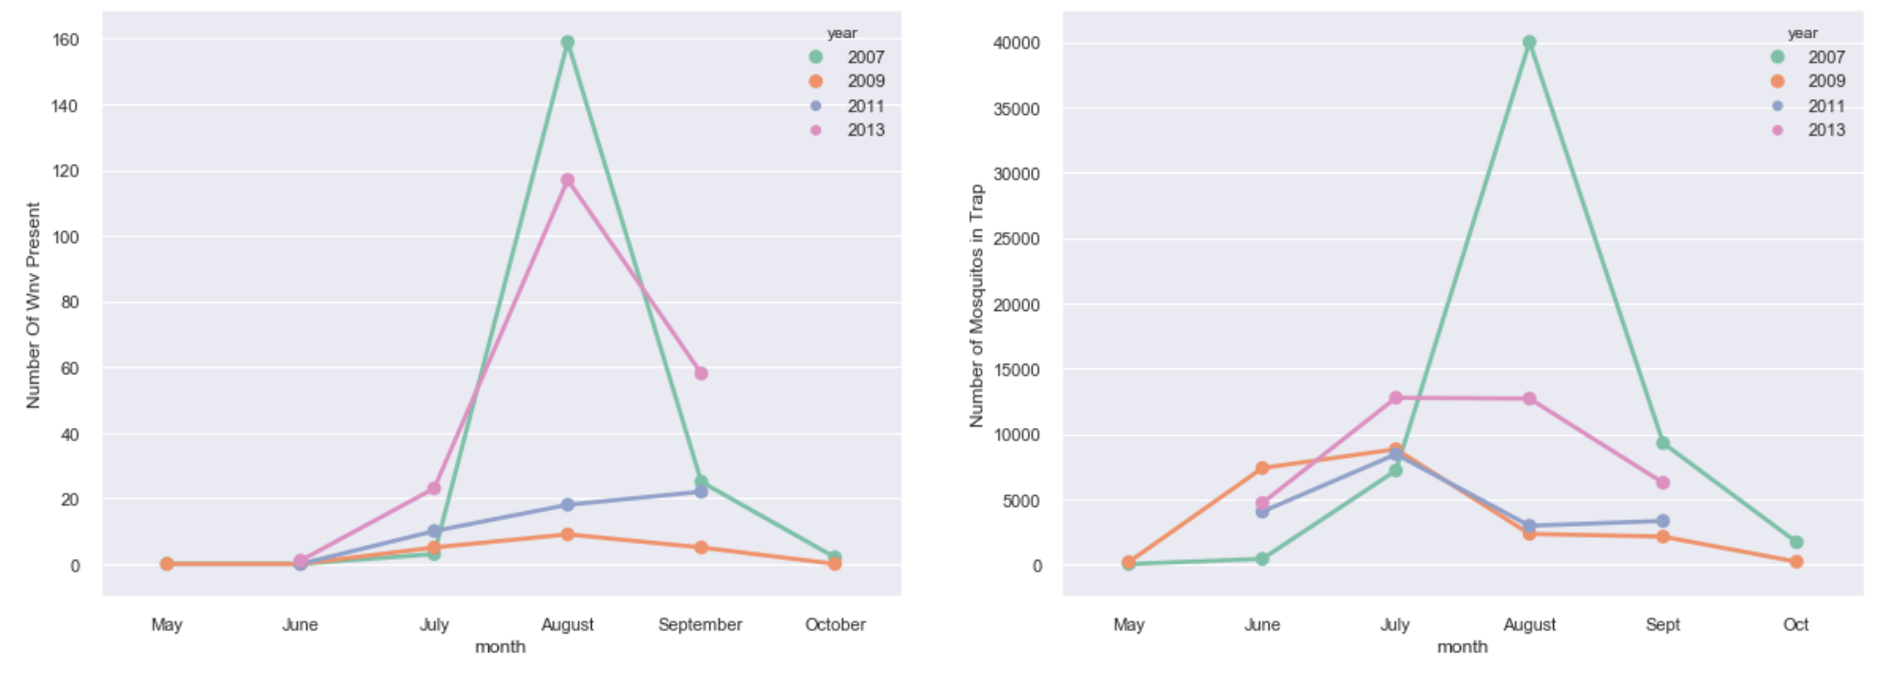
EDA - Trend of WNV across year
EDA - Trend of Mos Trapped
Notes:
July - Sept seems to be the VNR ‘season’ , peaks typically on August
Generally, WNR & Mos. Trapped seems to have the same pattern, but, there is a drastic change in 2013 August
Curioused to look into species

Slide 10
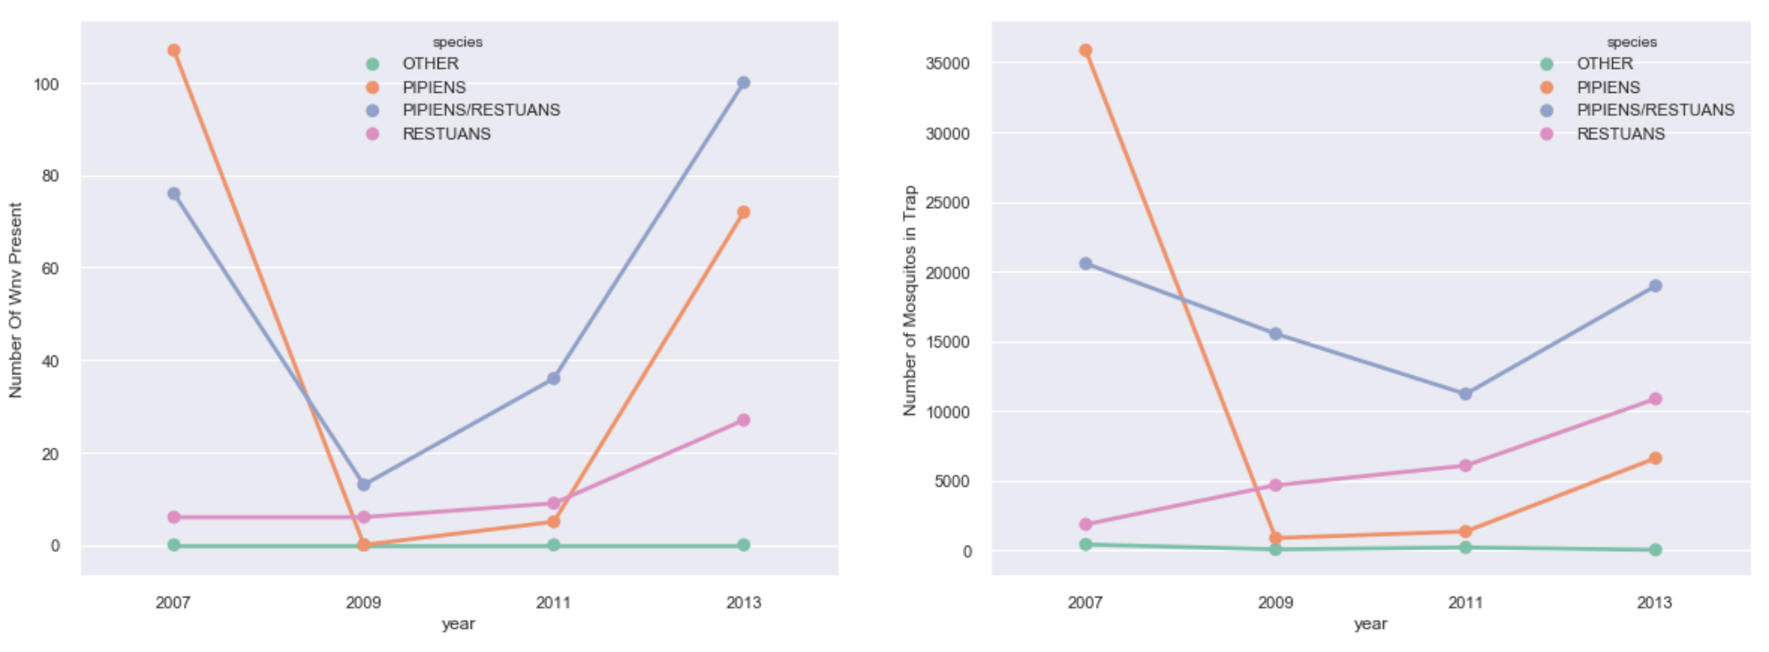
EDA - Species with WNV Across Species
EDA - Species Trapped across year
Notes:
Pipiens seems to be the more consistent species among all, that contribute to WNV transmission.
pipiens/restuans seem to have a opposite relationship during 2011,

Slide 11
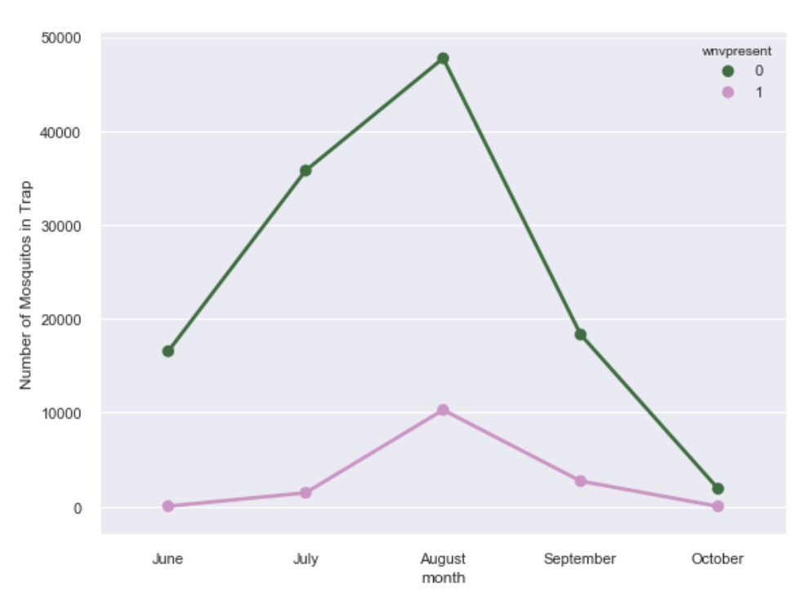
EDA - WNV vs Mos.
Findings so far:
2 Dominant species that contribute to the WNV transmission
July - Sept seems to be the VNR ‘season’
Peaks on August
Generally, WNR & Mos. Trapped seems to have the same trend, but, there is a drastic change in 2013 August.
Pipiens seems to be more of a species among all, that contribute to WNR transmission
Pipiens/Restuans seem to have a opposite relationship during 2011
Not all Mosquitos are transmitter of WNV

Slide 12
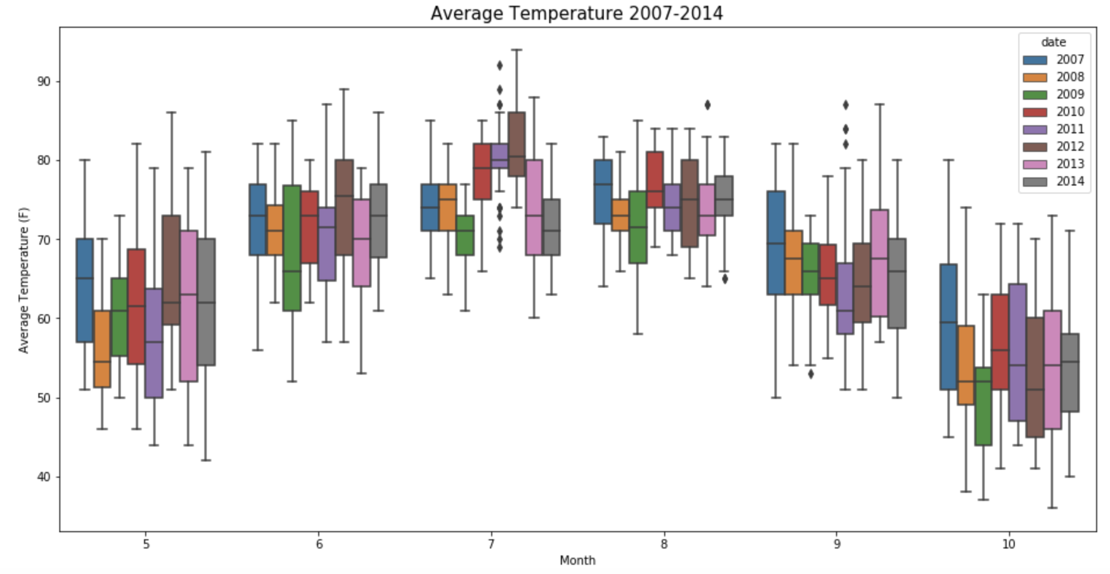
EDA - Trend of Tavg

Slide 13
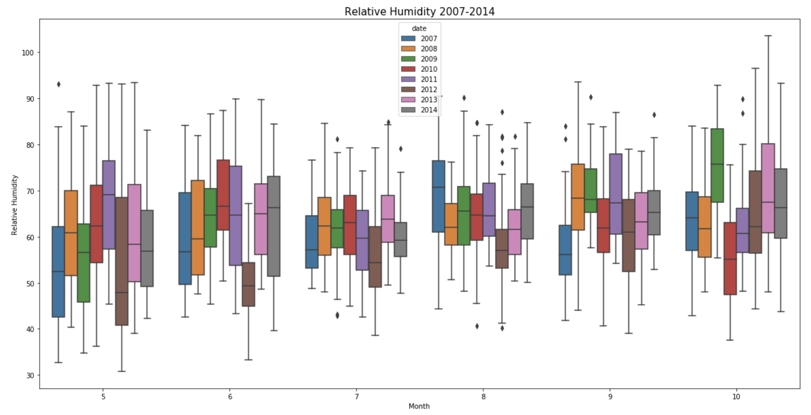
EDA - Trend of R.H.

Slide 14
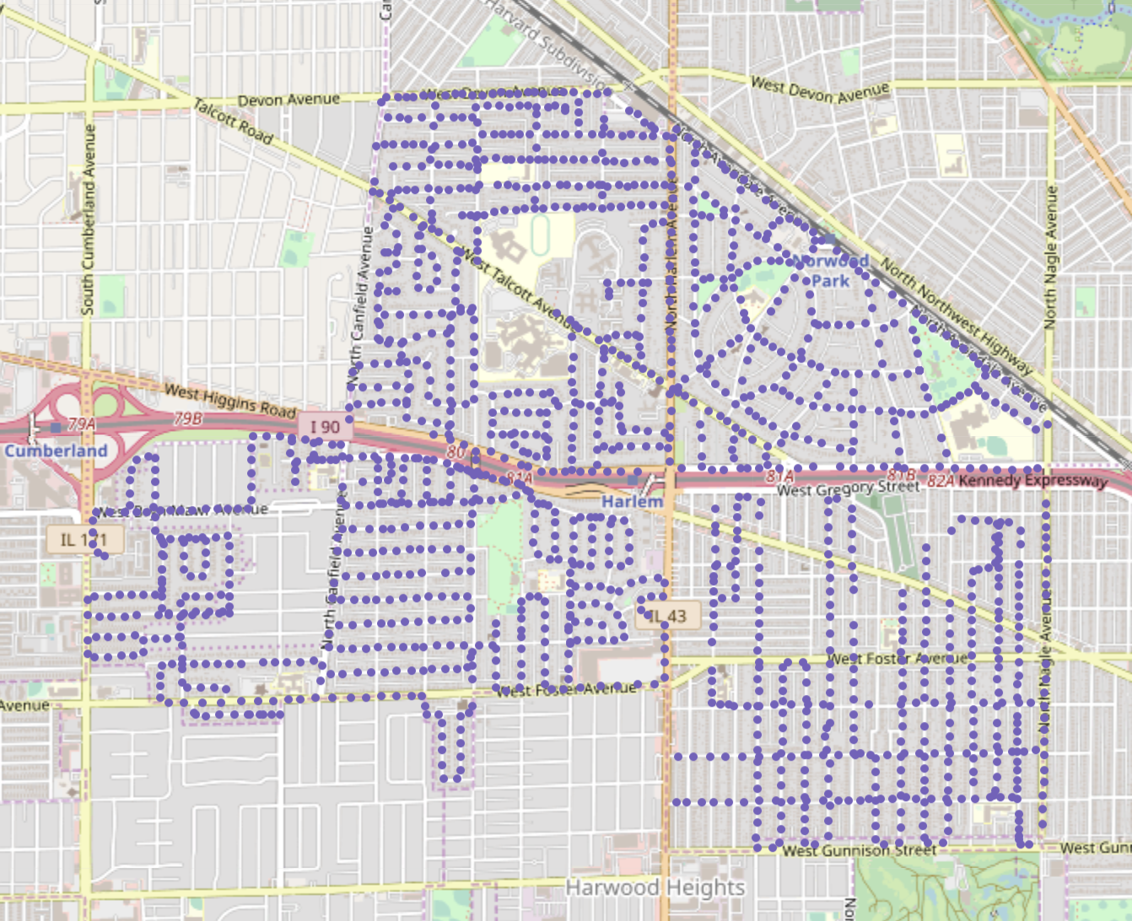
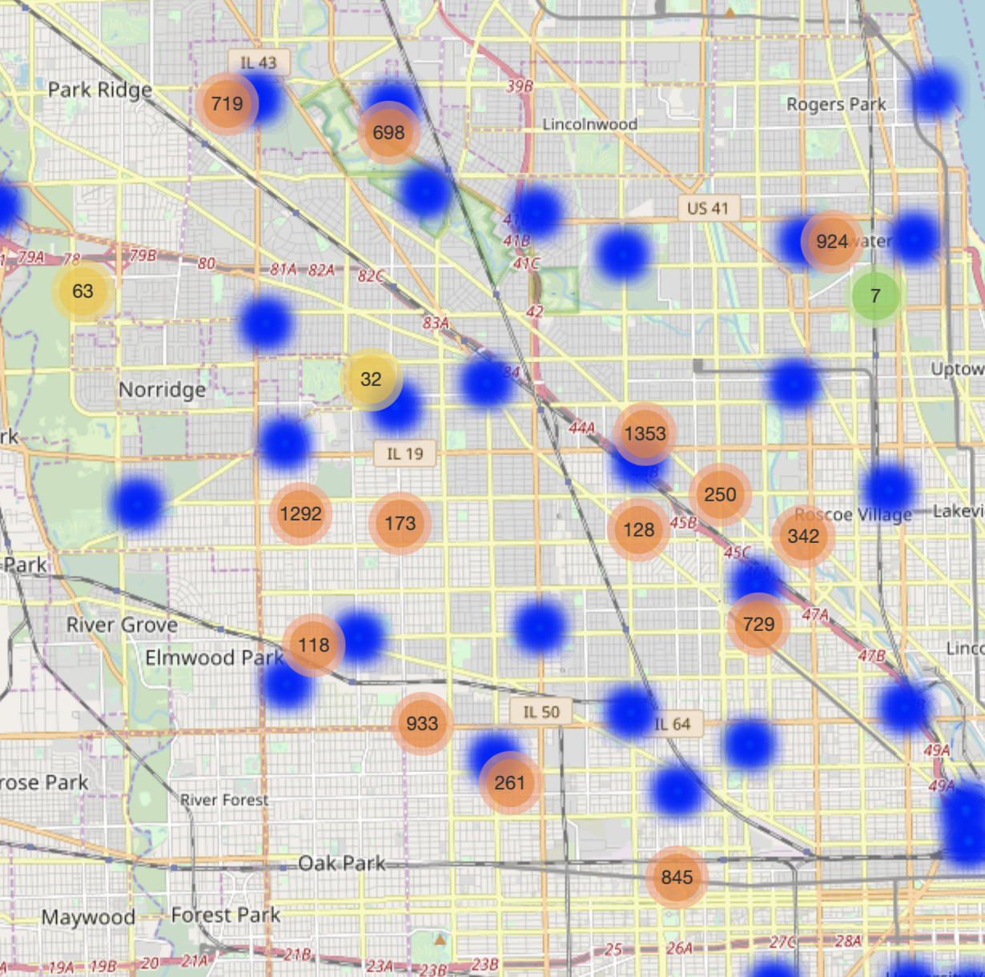
Spray cluster representation:

Slide 15
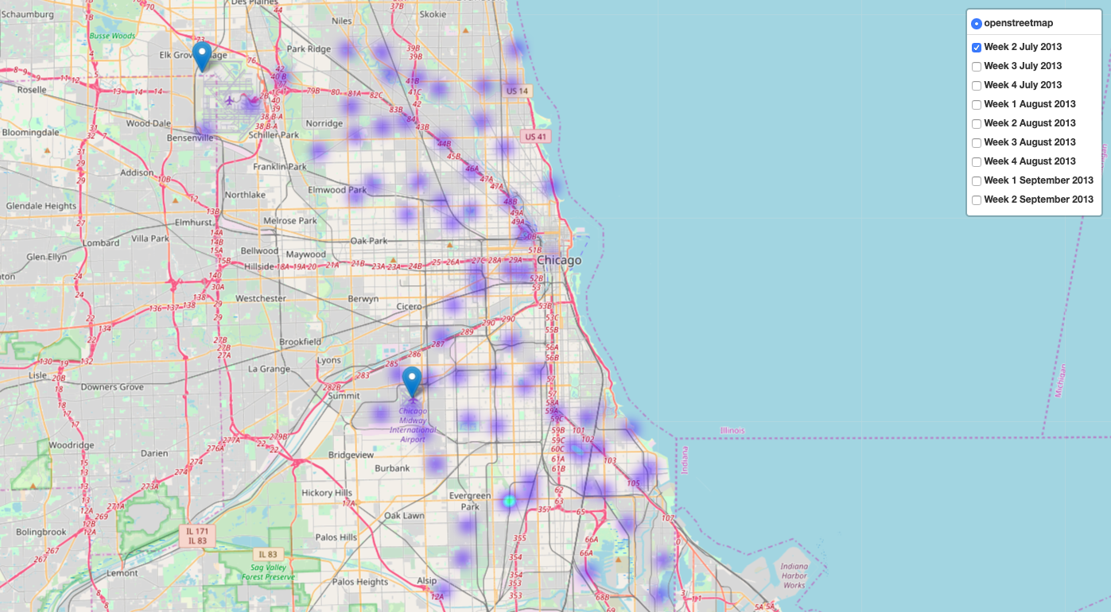
EDA - Effect of Spray (2013)
Week Before spray
c

Slide 16

EDA - Effect of Spray (2013)
Week of spray #1
17/07/2013

Slide 17
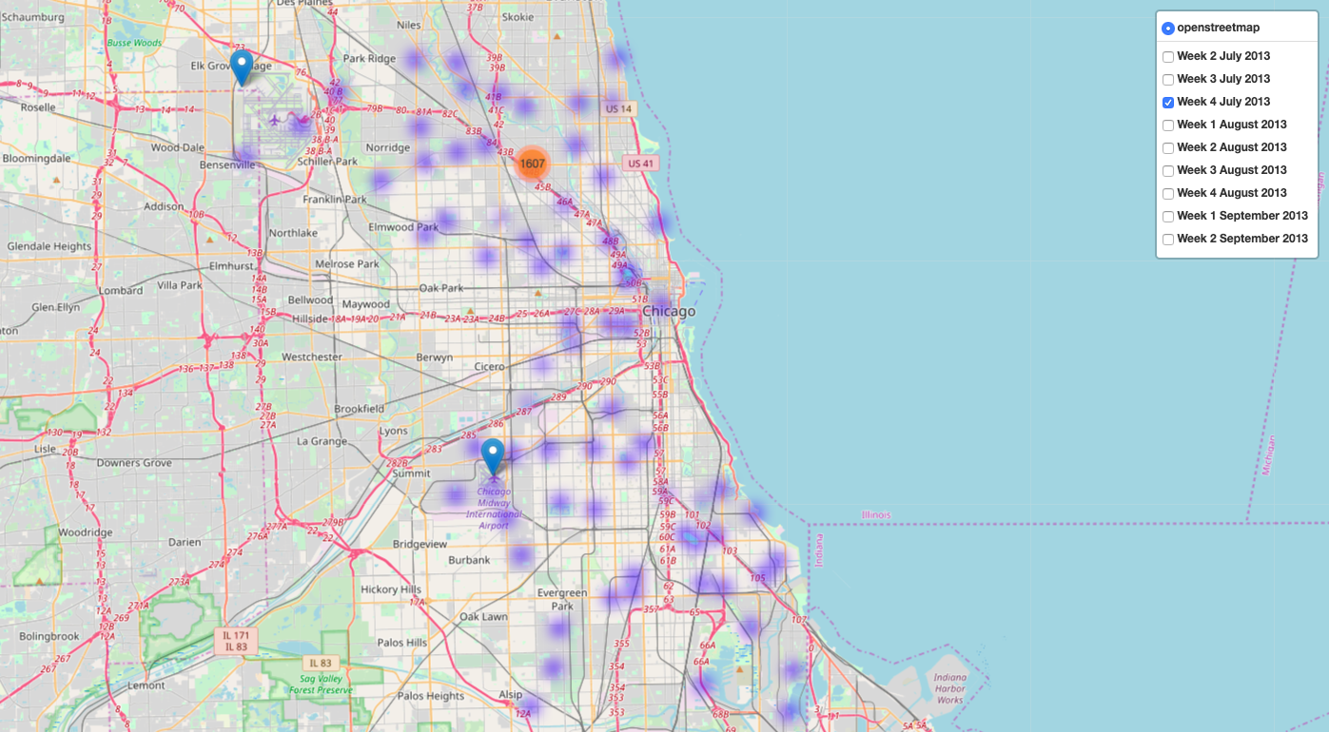
EDA - Effect of Spray (2013)
Week of spray #2
25/07/2013

Slide 18
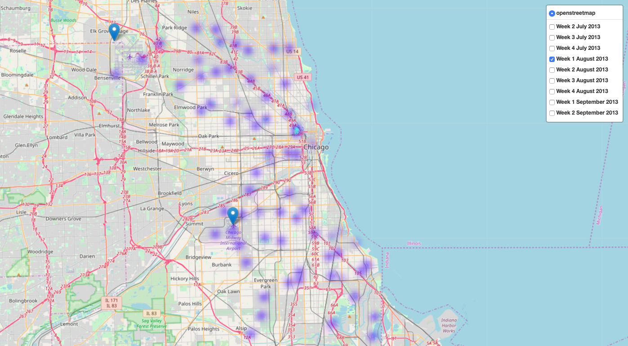
EDA - Effect of Spray (2013)
1 Week after Spray

Slide 19
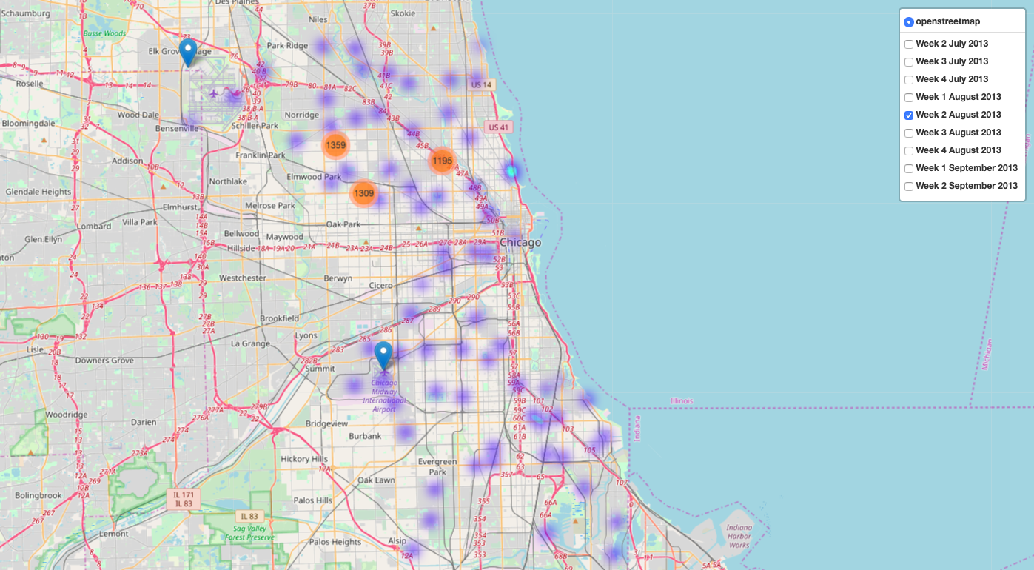
EDA - Effect of Spray (2013)
Week of spray #1
08/08/2013

Slide 20
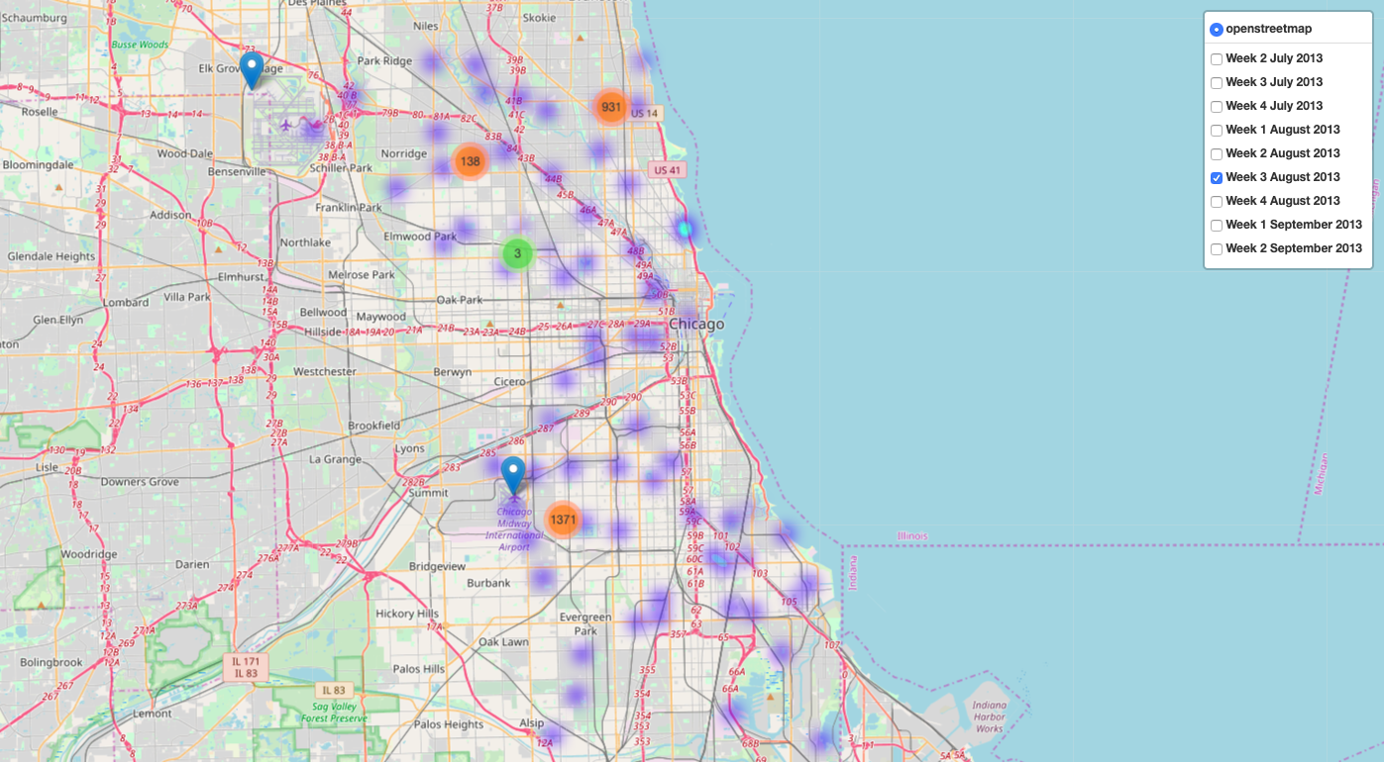
EDA - Effect of Spray (2013)
Week of spray #2
15 & 16/08/2013

Slide 21

EDA - Effect of Spray (2013)
Week of spray #3
22/08/2013

Slide 22
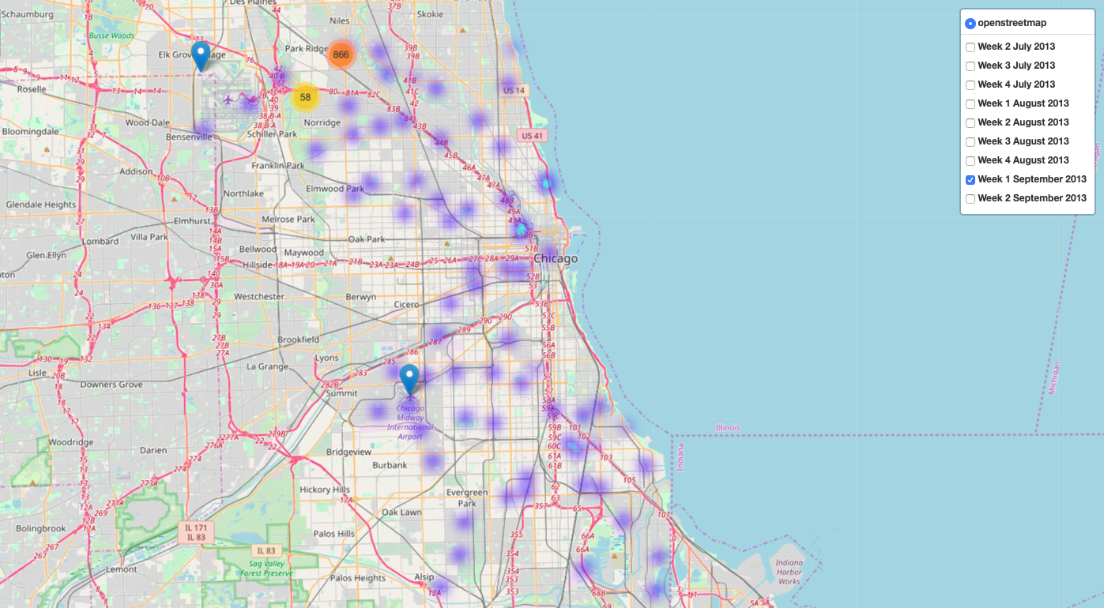
EDA - Effect of Spray (2013)
Week of spray #4
29/08/2013

Slide 23

EDA - Effect of Spray (2013)
1 Week after spray

Slide 24
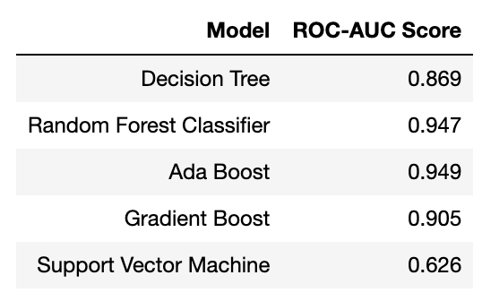
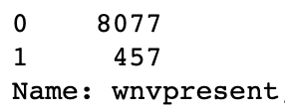
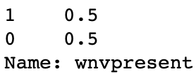
Model Selection & Evaluation

Slide 25
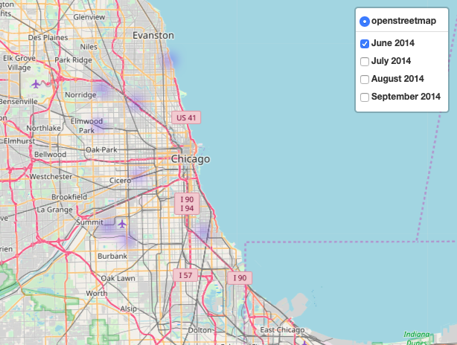
Predicted potential area with WNV

Slide 26
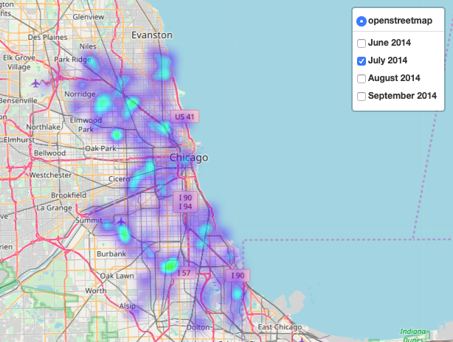
Predicted potential area with WNV

Slide 27
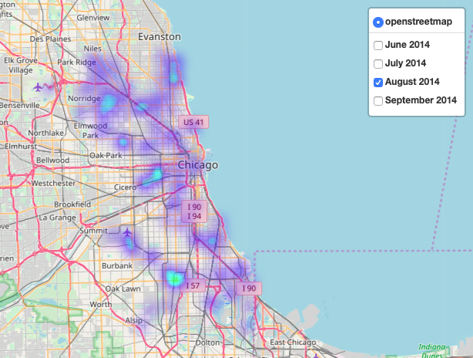
Predicted potential area with WNV

Slide 28
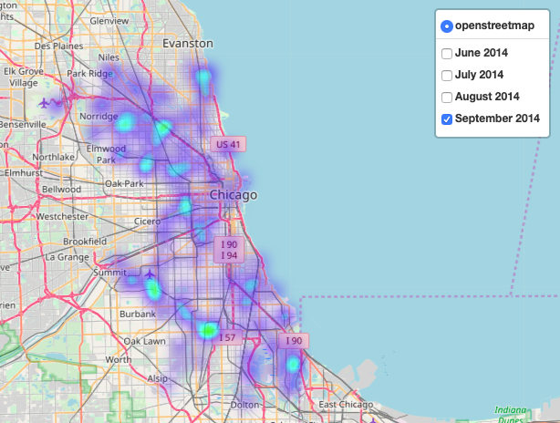
Predicted potential area with WNV

Slide 29


Cost Benefit Analysis
Cost
Cost of spray/vector control
Indirect Costs (hospitalisations, lost productivity)
Benefit
Economic Impact (on health, productivity)

Slide 30
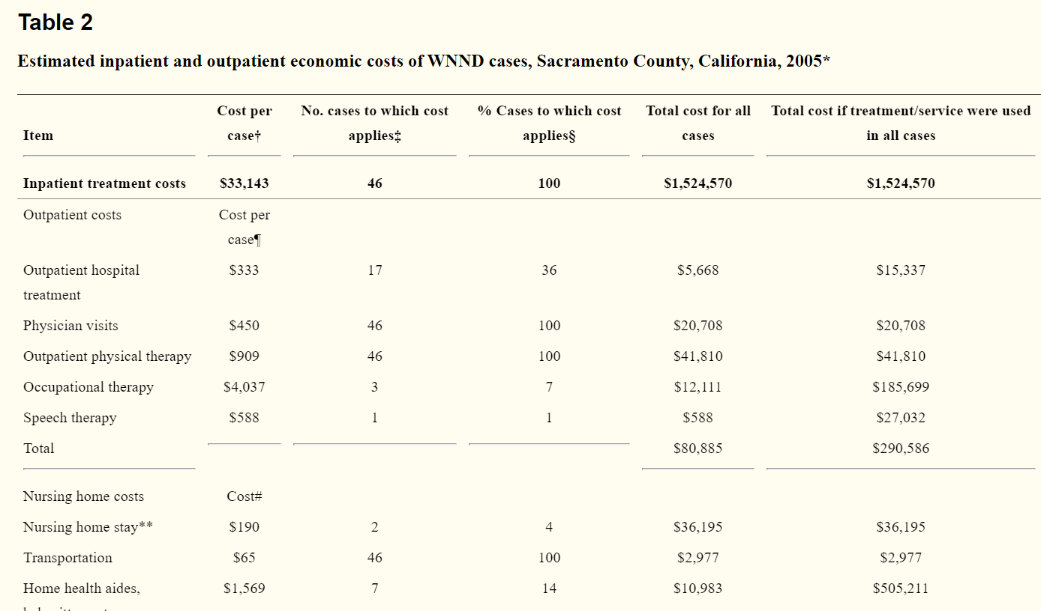



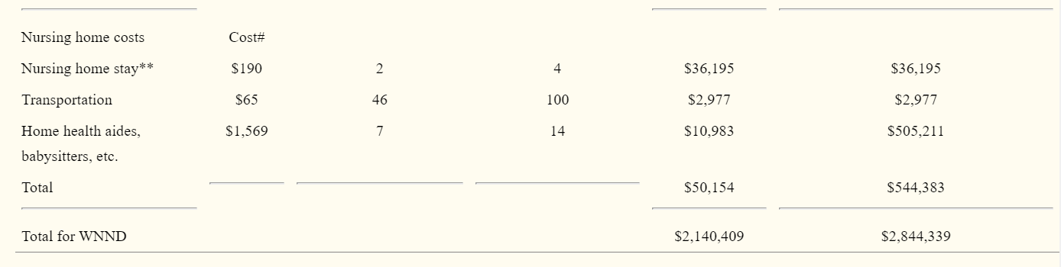
Case Study
In 2005, an outbreak of West Nile virus (WNV) disease occurred in Sacramento County, California.
163 Human Cases Reported
Economic Impact of the Outbreak
Vector Control Costs $701,790 (~477m²)
Medical Treatment & Productivity Lost $2.28 Mil
Cost Benefit Analysis
Total economic impact: $2.98 million.
Only 15 prevented cases of West Nile neuroinvasive disease to make the emergency spray cost-effective.
Source: National Center Biotechnology Information
Notes:
163 human cases were reported. In response to WNV surveillance indicating increased WNV activity, the Sacramento-Yolo Mosquito and Vector Control District conducted an emergency aerial spray. We determined the economic impact of the outbreak, including the vector control event and the medical cost to treat WNV disease. WNV disease in Sacramento County cost approximately $2.28 million for medical treatment and patients' productivity loss for both West Nile fever and West Nile neuroinvasive disease. Vector control cost approximately $701,790, including spray procedures and overtime hours. The total economic impact of WNV was $2.98 million. A cost-benefit analysis indicated that only 15 cases of West Nile neuroinvasive disease would need to be prevented to make the emergency spray cost-effective.

Slide 31
Conclusion & Recommendation
Jul and Aug as the target month for vector control
To monitor the predicted 9 clusters in 2014 as areas with a higher risk of WNV outbreak.
The cost of vector control should also factor other trade-offs such impact on health, medical bills and loss in productivity in order to have a better sense of the overall economic cost
Future work would include the use of medical data and the costs to have a more complete analysis.

